Slide 1
China development strategy for Nerandomilast SSc indication
Bo Wang
Dec 15, 2025

Slide 2
Executive Summary
China development strategy for Nerandomilast SSc indication
Background
PEC Discussion
The global strategy involves proceeding directly to a ph3 trial for the SSc indication without awaiting results from the ph2b CONQUEST trial, based on encouraging subgroup data for SSc-ILD from the FIBRONEER-ILD trial and supportive preclinical evidence.
China integration strategy for SSc project has been endorsed by CEC in Aug 2025.
Pre-CTA HAIs have been conducted in focus countries to gather feedback on the ph3 development plan.
Feedback from FDA, CDE and PMDA consistently highlighted that the current data is insufficient for a confirmatory ph3 trial in SSc. Risks for the final NDA approval of SSc indication were also raised.
RoFD for SSc was released by BUEC on Nov 18th and ph3 trial in SSc will be proceed.
Team Proposal
Considering about the potential risks with China CTA/EC approvals, local evidence team propose to submit China CTA after FDA feedback on US CTA.
Maintain close communication with global ET regarding the supplemental supporting evidence for the CTA
Maintain close communication with global ET and local AT about the future NDA strategy.
Rationale for PEC Discussion
For information sharing and for advice
✔ For Sharing ✔ For Advice □ For Endorsement

Slide 3
Disease background

Slide 4








Systemic sclerosis (SSc) is a persistent autoimmune rheumatic disorder affecting multiple organs, with significant unmet needs in therapeutic options.
Common manifestations of SSc^{1,4,5}
Hand swelling and puffiness
Muscle and joint pain
    The pathogenesis of SSc is characterized by a complex interplay of vasculopathy, immune dysregulation and progressive fibrosis^{1–4}
    SSc is clinically heterogeneous and can affect the skin and several internal organs^{1,4,5}
    ILD is the most common and the leading cause of mortality among complications in patients with SSc. Globally, the prevalence of ILD in SSc patients is 50%-80%⁶.
Lung involvement
(ILD and PAH)
Calcinosis
Digital ulcers
Skin thickening
and color changes
    Although some drugs are licensed to treat specific complications of SSc, there is a lack of approved treatments for SSc that can address disease pathogenesis and halt disease progression^{5, 7-8}
    - Nintedanib (TKI): approved for SSc-ILD (including China);
    - Tocilizumab (anti-IL-6): approved for SSc-ILD in US;
    - Rituximab (anti-CD20): approved for SSc in Japan.
Raynaud’s phenomenon
GI issues
GI, gastrointestinal; ILD, interstitial lung disease; PAH, pulmonary arterial hypertension; RP, Raynaud's phenomenon; SSc, systemic sclerosis
1. Allanore Y et al. Nat Rev Dis Primers 2015;1:15002; 2. Matucci-Cerinic M et al. Arthritis Rheum 2013;65:1953–62; 3. Roofeh D et al. Expert Opin Emerg Drugs 2020;25:455–66;
4. Hughes M et al. Eur J Rheumatol 2020;7:100–9; 5. Denton CP et al. Lancet 2017;390:1685–99. 6. Perelas A, et al. Lancet Respir Med. 2020;8(3):304-320; 7. Volkmann ER et al. Lancet 2023;401:304–18; 8.. Liakouli V et al. Nat Rev Rheumatol 2024;20:21–32
4

Slide 5
Supporting Evidence for Nerandomilast Development in SSc

Slide 6
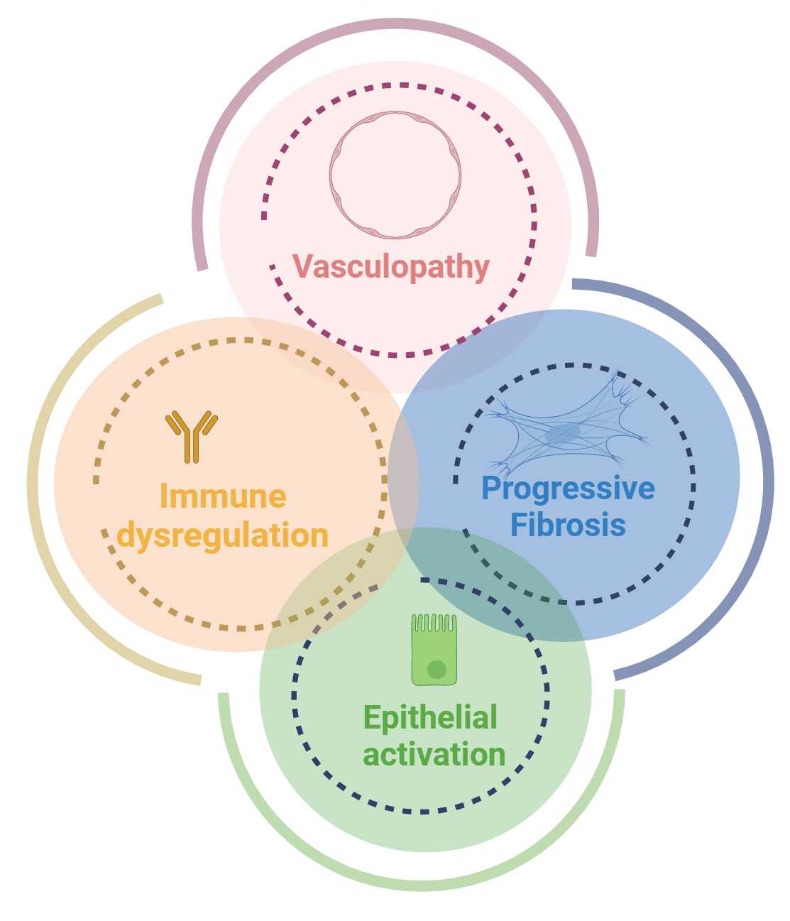
Preclinical evidence on Nerandomilast in SSc
Potential to directly impact endothelial activation (literature and emerging in-house data) and indirectly through suppression of inflammation
Potential to directly attenuate inflammation by modulating macrophage and lymphocyte activation and suppression of pro-inflammatory cytokines and IFNs (activities on macrophages are differentiated from MMF)
Pre-clinical data show direct anti-fibrotic effects on lung and SSc skin fibroblasts and suppression of epithelial cell and keratinocyte pro-fibrotic activation
Potential to directly attenuate skin fibrosis by inhibiting pro-fibrotic activation of keratinocytes and promoting barrier function
Pre-clinical data demonstrate that nerandomilast targets key pathogenic mechanisms of SSc — fibrosis, vasculopathy, and immune dysregulation — across relevant in vitro and in vivo models, with effects observed at clinically relevant concentrations. Importantly, these effects were not limited to the lung but also included skin and vascular tissues, supporting its potential for systemic disease modification.

Slide 7
Evidence from subgroup analyses in patients with SSc-ILD (trial 1305-0023)
The analysis of primary and key secondary endpoints in a subgroup of patients with SSc-ILD, though based on a relatively small sample size (n=75), provides compelling evidence supporting the potential efficacy of nerandomilast in this patient population.
In the SSc-ILD subgroup, nerandomilast showed numerically favorable trends in both primary and key secondary endpoints, despite the limited sample size. Safety data in this subgroup were generally consistent with the overall safety profile.
These findings support the clinical relevance of the pre-clinical data and justify further evaluation of nerandomilast on ILD and other organ manifestations in SSc in a confirmatory Phase III trial.

Slide 8
In the SSc-ILD subgroup, nerandomilast showed numerically favorable trends in both primary and key secondary endpoints, despite the limited sample size
Change in FVC at W52
Change in FVC over 52 weeks
 | Placebo (n=23) | Nera 9 mg bid (n=25) | Nera 18 mg bid (n=27)
Baseline, mean (SD), mL | 2045.30 (631.65) | 2199.48 (678.28) | 2012.93 (576.14)
Week 52 change from baseline, adjusted mean, mL | -116.13 (-220.24, -12.03) | -49.13 (-146.31, 48.05) | 0.54 (-93.87, 94.95)
Adjusted mean vs. placebo, mL |  | 67.00 (-75.31, 209.32) | 116.67 (-23.58, 256.93)
Time to first acute ILD exacerbation, hospitalization for respiratory case or death
 | Placebo (n=23) | Nera 9 mg bid (n=25) | Nera 18 mg bid (n=27)
Number of patients (N %) | 23 (100) | 25 (100) | 27 (100)
Number of patients with event (N %) | 6 (26.1) | 4 (16.0) | 4 (14.8)
- Acute ILD exacerbation | 3 (13.0) | 0 | 2 (7.4)
- Hospitalisation for respiratory cause | 1 (4.3) | 3 (12.0) | 2 (7.4)
- Death | 2 (8.7) | 1 (4.0) | 0
HR vs placebo |  | 0.55 | 0.37
95% CI |  | 0.15, 1.94 | 0.10, 1.32

Slide 9
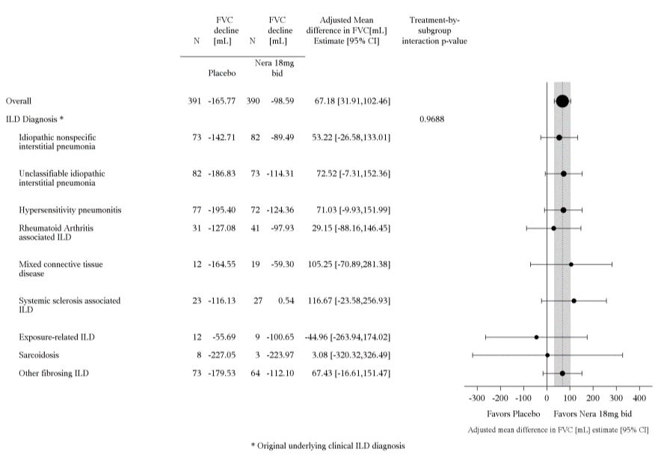
Efficacy results across subgroups based on various ILD diagnoses
Primary endpoint: Nera 18mg vs. placebo
Key secondary endpoint: Nera 18mg vs. placebo

Slide 10
The safety profile of nerandomilast in SSc-ILD subgroups was generally consistent with that in the overall trial population
FIBRONEER-ILD Trial
Category of AEs DBL1 | Overall population |  |  | Patients with SSc-ILD
 | Placebo N(%) | Nerandomilast 9 mg bid N(%) | Nerandomilast 18 mg bid N(%) | Placebo N(%) | Nerandomilast 9 mg bid N(%) | Nerandomilast 18 mg bid N(%)
Patients treated | 392(100.0) | 393(100.0) | 391(100.0) | 23 (100.0) | 25(100.0) | 27(100.0)
Patients with any AE | 369 (94.1) | 369 (93.9) | 364 (93.1) | 21(91.3) | 21(84.0) | 26(96.3)
Severe AEs (CTCAE grade >2) | 146(37.2) | 139(35.4) | 145(37.1) | 6(26.1) | 7(28.0) | 13(48.2)
AEs leading to permanent treatment discontinuation | 46 (11.7) | 39 (9.9) | 44 (11.3) | 2(8.7) | 2(8.0) | 3(11.1)
Serious AEs | 168 (42.9) | 150 (38.2) | 154 (39.4) | 10(43.5) | 8(32.0) | 11(40.7)
Resulted in death | 29 (7.4) | 18 (4.6) | 8 (2.1) | 3(13.0) | 1(4.0) | 0(0)
CTCAE, Common Terminology Criteria for Adverse Events.

Slide 11
Summary
The combined non-clinical and clinical data provide a strong scientific rationale to initiate a Phase III trial of nerandomilast in SSc.
Pre-clinical data demonstrate that nerandomilast targets key pathogenic mechanisms of SSc — fibrosis, vasculopathy, and immune dysregulation — across relevant in vitro and in vivo models, with effects observed at clinically relevant concentrations. Importantly, these effects were not limited to the lung but also included skin and vascular tissues, supporting its potential for systemic disease modification.
Clinically, nerandomilast has demonstrated consistent efficacy and safety in two large Phase III trials in fibrosing ILDs (IPF and PPF). In the SSc-ILD subgroup, nerandomilast showed numerically favourable trends in both primary and key secondary endpoints, despite the limited sample size. Safety data in this subgroup were consistent with the overall safety profile.
These findings support the clinical relevance of the pre-clinical data and justify further evaluation of nerandomilast on ILD and other organ manifestations in SSc in a confirmatory Phase III trial.

Slide 12
SSc Ph3 (1305-0052) Study Design Overview

Slide 13


1305-0052: Trial Design (as of Dec 2nd)
The main entry criterion for the trial is that patients are at least 18 years of age diagnosed with SSc (dcSSc or lcSSc).
Nerandomilast 18 mg bid*
N ≈448
Screening
R 1:1
Placebo
Visit
1 2
3
4
5 6
7
8
9
10 11 12
Day
253 281 309 337 365
30 36 40 44 48 52
1- 6 wks
1
43
85
127
169
211
Week Window
0 6
12 18
24
**On-site visits every 12 weeks,
&
visit every
6 weeks after each on-site visit
±7d
±7d
±2d
±7d
±2d
±7d
±2d ±7d ±2d
±7d
±14d
Screening | Treatment Period A | Treatment Period B** | EoT | Fup/ EoS
*During the treatment period, based on the individual patient tolerability, possible temporary reduction to 9 mg bid
** Treatment Period B to continue until at least 283 primary endpoints events have been achieved and the last randomized patient on trial treatment reaches 52 weeks of treatment
| CONFIDENTIAL

Slide 14
1305-0052: Primary Endpoint and Key Secondary Endpoints
Primary Endpoint:
Time to the first occurrence of disease progression or all-cause death:
Adjudicated SSc-related clinically meaningful disease progression or complications*, or
Absolute decline in FVC% predicted ≥5%, or
Relative increase in mRSS ≥25% and absolute increase in mRSS ≥5 points, or
All-cause death
Key secondary Endpoints
Change from baseline in FVC (ml) at Week 52
Change from baseline in mRSS at Week 52
The primary endpoint proposed in the 1305-0052 trial has not been used as the primary endpoint in other pivotal trials for SSc.
Nerandomilast in SSc | CONFIDENTIAL

Slide 15
Pre-CTA HAI feedbacks

Slide 16
Question List
Given the pre-clinical data suggesting a potential therapeutic effect of nerandomilast on SSc beyond pulmonary involvement, the encouraging efficacy signals observed in the SSc-ILD subgroup analysis from the FIBRONEER™-ILD trial, and the substantial efficacy and safety data already available from Phase 3 trials in IPF and PPF, does CDE support the rationale to proceed directly to a Phase III clinical trial in patients with SSc, without conducting a dedicated Phase II trial in this population?
Does the CDE agree that the proposed Phase III trial (1305-0052) is appropriately designed and powered to evaluate the efficacy of nerandomilast for the treatment of SSc, including the adequacy of the study population and endpoints to support the target indication of “Treatment of SSc”?
Does the CDE concur that the statistical analysis strategy of the proposed Phase III trial (1305-0052) is set up sufficiently to provide evidence of efficacy for nerandomilast in the targeted indication including the scenario of positive interim analyses?
Does the CDE concur that the proposed Phase III Trial (1305-0052) is adequately designed to determine safety of nerandomilast in adult patients with SSc?
Does the CDE agree with the proposed dose regimen to be tested in the proposed Phase III trial (1305-0052)?

Slide 17
Overview of Feedback Received from FDA, CDE, and PMDA Following the Pre-CTA HAI
FDA: The SSc-ILD subgroup data’s relevance to the broader SSc population remains uncertain; a ph 2 dose-finding/POC trial is recommended to guide ph3; conducting a ph3 trial based on available data is at your discretion.
CDE: current evidence is insufficient to justify proceeding directly to a pivotal trial for SSc; a dose-exploratory trial for SSc or provide additional evidence would support advancing to a pivotal trial for SSc.
PMDA: trial cannot be considered a confirmatory study due to insufficient evidence.
Proceed directly into a Ph3 in SSc without conducting a dedicated ph2
FDA: No regulatory precedent exists regarding primary endpoint; efficacy must show improvement across multiple core components; variability in assessment and interpretation (e.g. mRSS) should be considered; dose reduction impact on efficacy and safety need to be considered; data from the planned ph 3 study in the SSc-ILD subgroup may support an independent SSc-ILD indication.
CDE: /.
PMDA: Interpreting the results may be difficult, and there is a high risk that a negative judgment may have to be made even if proposed primary endpoint meets; no intention to halt the conduct of the 1305-0052 trial due to no safety concerns; even if a pre-NDA consultation is conducted based on the trial’s findings, there is concern that it may not result in NDA approval.
Overall study design to support target indication of “treatment of SSc” (study population, endpoints, statistical analysis strategy, safety, dose regimen)
RoFD in SSc has been released by BUEC on Nov 18th , and ph3 in SSc will be proceeded as planned.

Slide 18
China CTA/EC/NDA considerations

Slide 19
Team evaluation and proposal
Based on global team feedback, only additional pre-clinical data can be provided in CTA package.
Potential risks related to China CTA, EC and NDA were identified.
- CTA: CDE has not yet provided feedback regarding the specific study design and further review will be needed during CTA review; although the likelihood of CDE directly rejecting the CTA application is low, the approval letter may include remarks related to insufficient evidence and concerns.
- EC: Concerns may be raised by site ECs due to unclear risk-benefit profile in SSc patients, which could potentially impact the subsequent trial execution.
- NDA: remarks on the HAI feedback and CTA approval letter need to be addressed in NDA submission; approval of SSc indication may be challenging.
Team proposal: submit China CTA after FDA feedback on US CTA.
- Pros: New IND released by FDA may support China CTA/EC arguments.
- Cons: 1~2 months delay in leading site EC submission (only a minimal impact on patient enrollment in China).
China CTA submission strategy has been endorsed by CEC in Nov and aligned with global ET.
Risks associated with final NDA approval were communicated to local AT in Nov.

Slide 20



Nerandomilast (PDE4b inhibitor): Systemic Sclerosis (SSc) Development Plan
2025 |  |  |  | 2026 |  |  |  | 2027 |  |  |  | 2028 |  |  |  | 2029 |  |  |  | 2030 |  |  |  | 2031
Q1 | Q2 | Q3 | Q4 | Q1 | Q2 | Q3 | Q4 | Q1 | Q2 | Q3 | Q4 | Q1 | Q2 | Q3 | Q4 | Q1 | Q2 | Q3 | Q4 | Q1 | Q2 | Q3 | Q4 | Q1 | Q2 | Q3 | Q4
We are here
31Jan 2027
15Apr 2028
Ph2b-1305.40
CONQUEST Trial, SSc-ILD, ph2b
IA
Key results
15 Aug 2025
18 Nov 2025
Feb
2026
9 Jun
2026
12Apr 2030
Aug2030
Feb 2031
Ph3-1305.52
Mar
2026
SSc Ph3 (N=448, 32 months)
RoFD
CTA sub.
CTA appr.
DBL
NDA appr.
HAI
FSS
NDA sub.
China
Ph3-
1305.52
21 Aug 2025
Mar
2026
Sep Oct 2026
Sep 2030
Jul 2031
SSc Ph3 (N=45, ~27 months)
HAI
CTA sub.
FSS
NDA sub.
NDA appr.
Follow-up actions:
- HAI response will be prepared and incorporated into the CTA submission packages.
- Maintain close communication with global ET regarding the supplemental supporting evidence for the CTA.
- Maintain close communication with global ET and local AT about the future NDA strategy.

Slide 21
Thank you

Slide 22
Back up slides

Slide 23
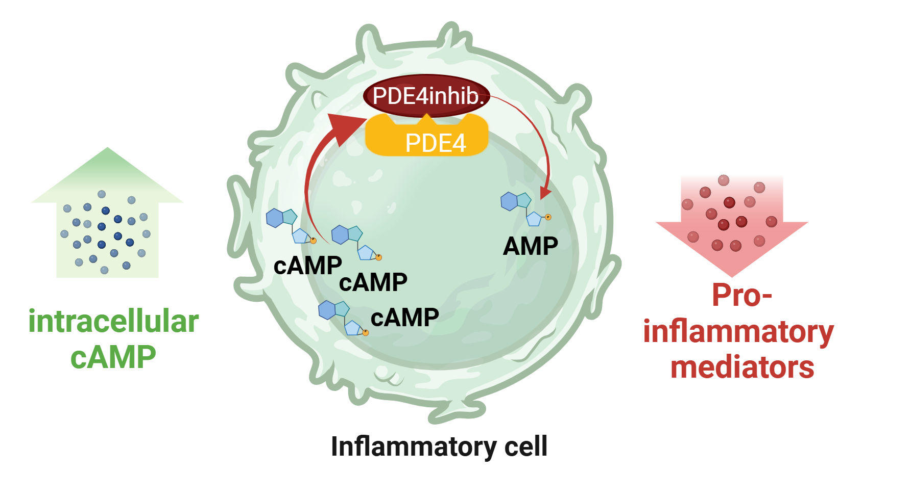
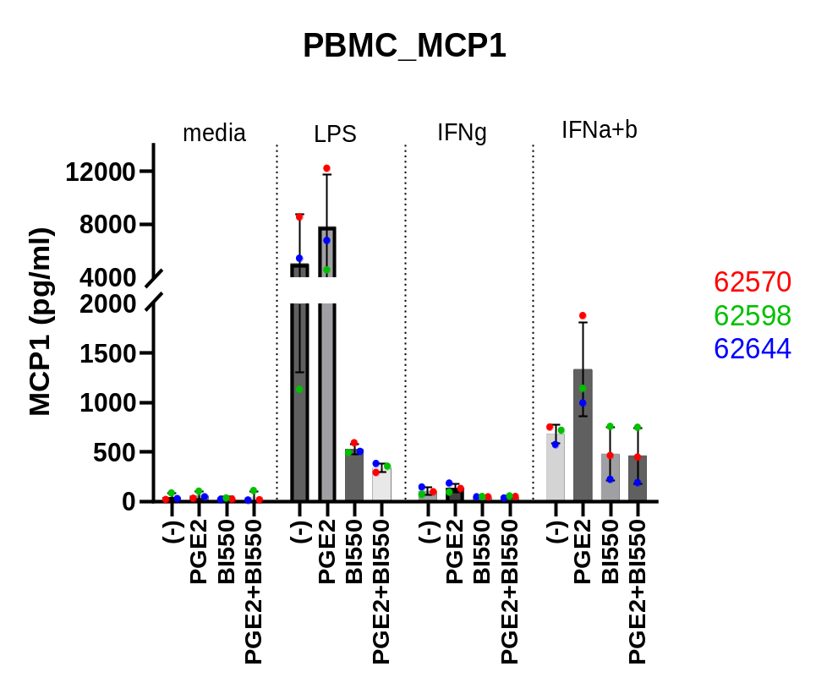
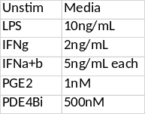
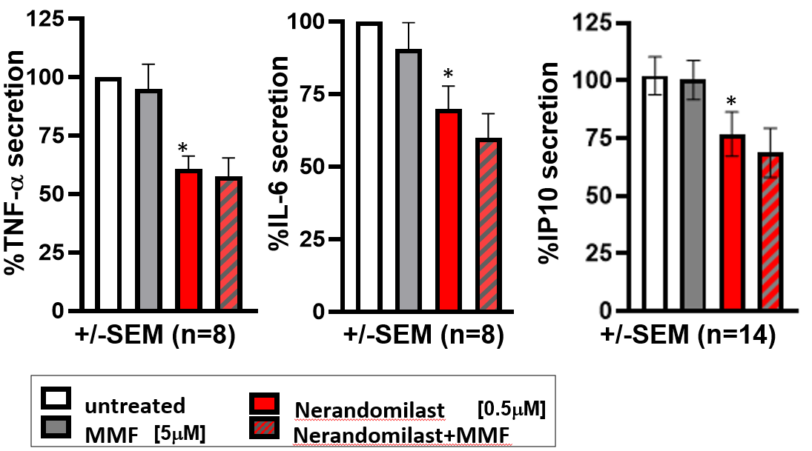
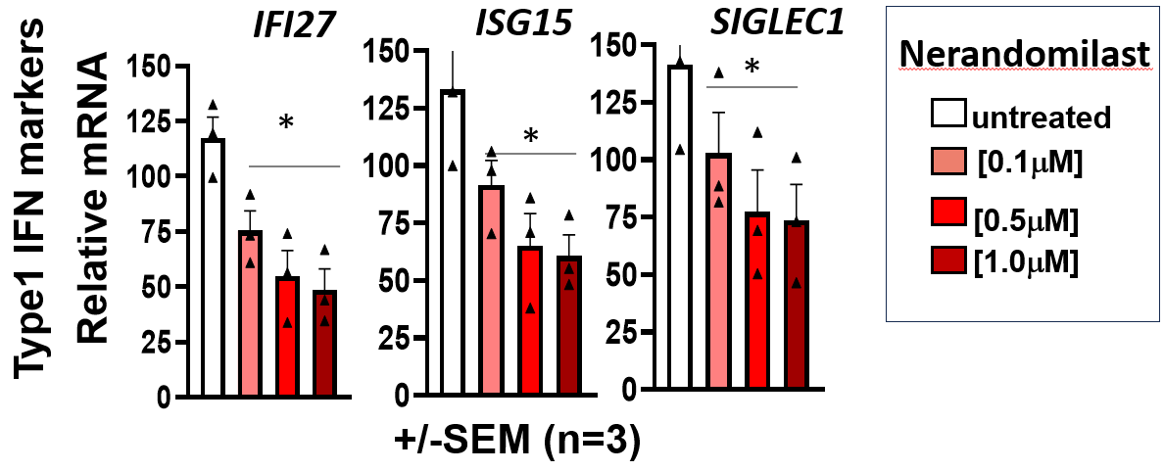
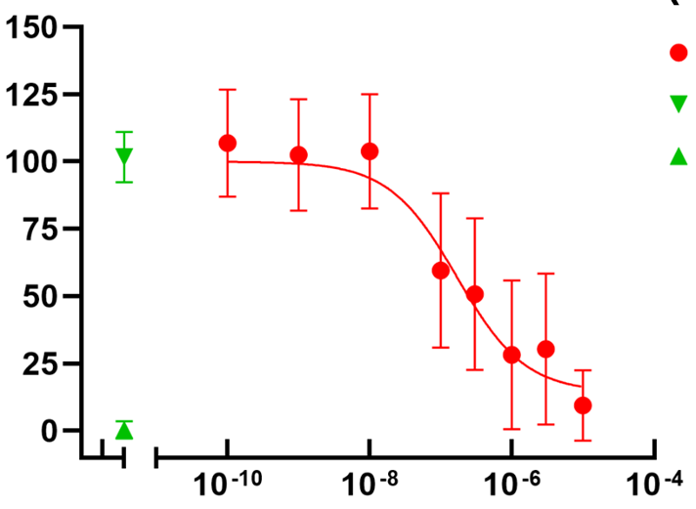
Anti-Inflammatory Effect of Nerandomilast
Nerandomilast inhibits activation of multiple disease mediating inflammatory cells
PBMCs
Monocyte derived Mac (LPS-stim.)
Anti-inflammatory effect on multiple immune cells
iDMs (tissue res. Mac, LPS-stim.)
(-)
Nera
(-)
Nera
(-)
PGE2
PGE2
Nera
PGE2/Nera
PGE2/Nera
PGE2
PGE2/Nera
T cells
PBMCs
Monocyte derived macrophages
iPSC derived macrophages
(model of tissue resident macrophages)
Suppresses biomarker MCP-1
T cells
IFNγ production of anti-CD3/anti-CD28
stimulated human CD4+ T cells
Nerandomilast
Pos. cntrl
Normalized IFNγ
Neg. cntrl
(6 donors,
+/-SEM)
Note: The concentrations used of Nerandomilast in the in vitro studies (500nM) reflect the exposure level in patients receiving 18mg bid Neradnomilast.
Molar

Slide 24
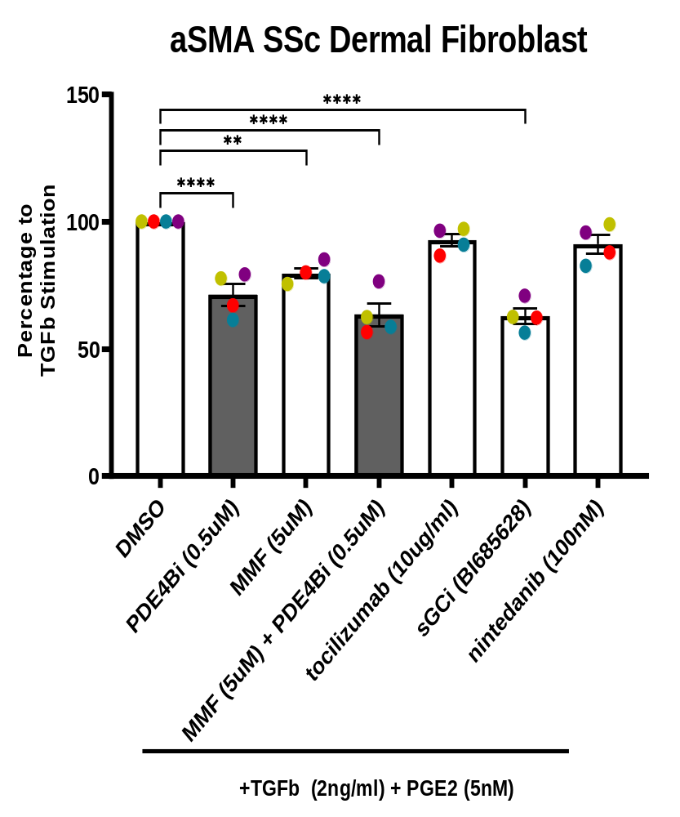
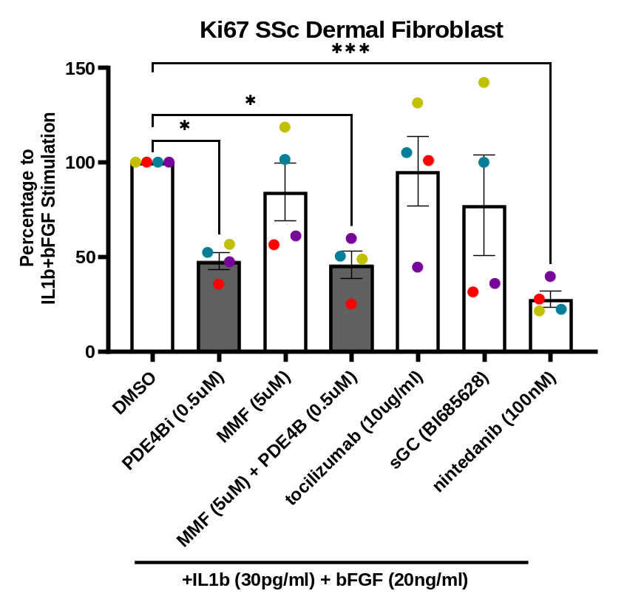
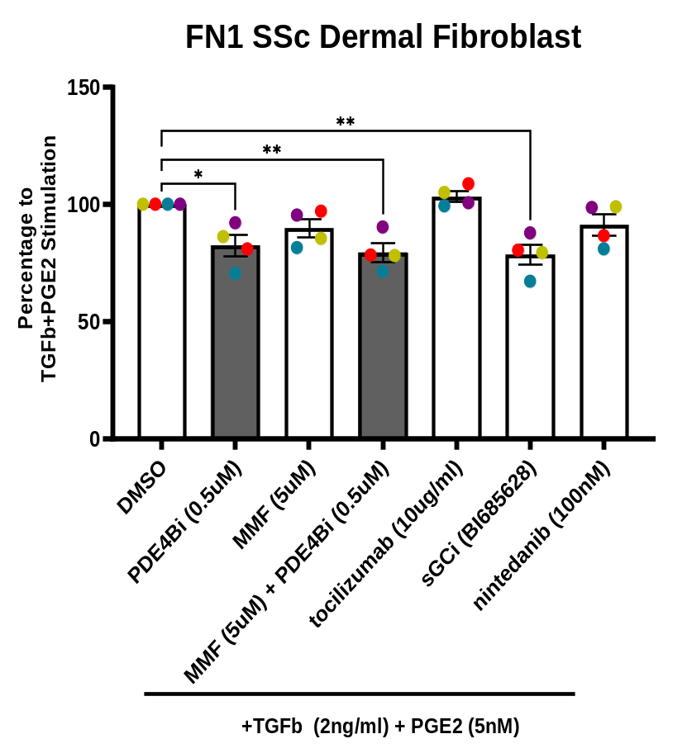
Nerandomilast suppresses dermal fibroblast activation suggesting direct anti-fibrotic effects in SSc
Skin Fibroblasts from SSc Patients
Proliferation
Fibronectin
α-Smooth muscle actin
% IL-1β + bFGF
% TGFβ + PGE₂
% TGFβ + PGE2
VC
PDE4Bi
MMF
PDE4Bi
VC
PDE4Bi
MMF
PDE4Bi
VC= DMSO
PDE4Bi 0.5μM
MMF
VC= DMSO
PDE4Bi 0.5μM
MMF
VC
PDE4Bi
MMF
PDE4Bi
IL-1β + bFGF
n=4 donors
TGFβ + PGE2
n=4 donors
VC= DMSO
PDE4Bi 0.5μM
MMF
MMF 5μM
MMF 5μM
MMF 5μM
TGFβ + PGE2
n=4 donors
PGE2 at 1nM; TGFb at 5ng/ml
bFGF (20 ng/mL),IL-1β (30 pg/mL)
24

Slide 25
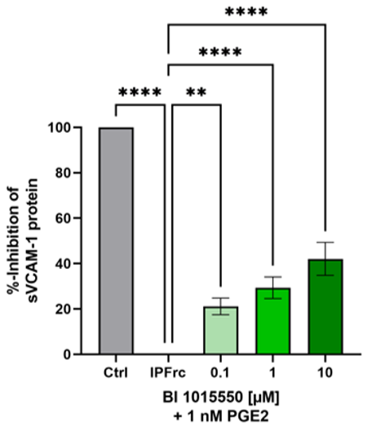
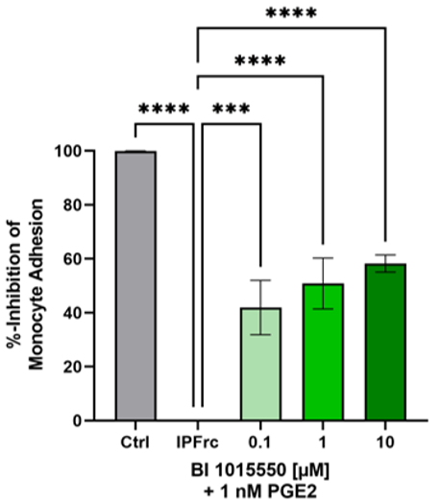
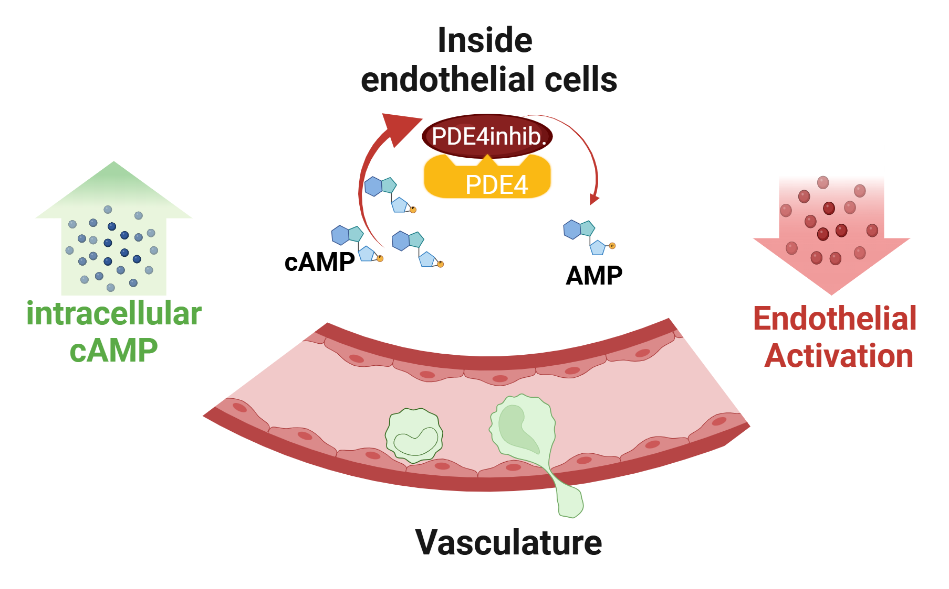
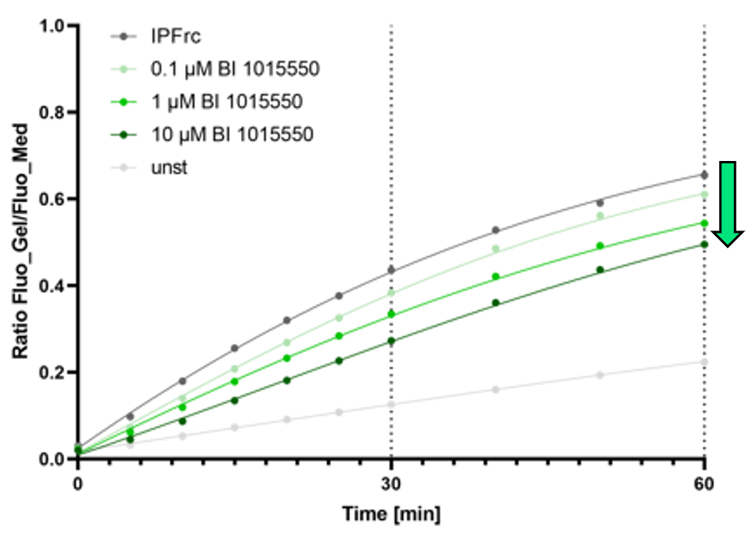
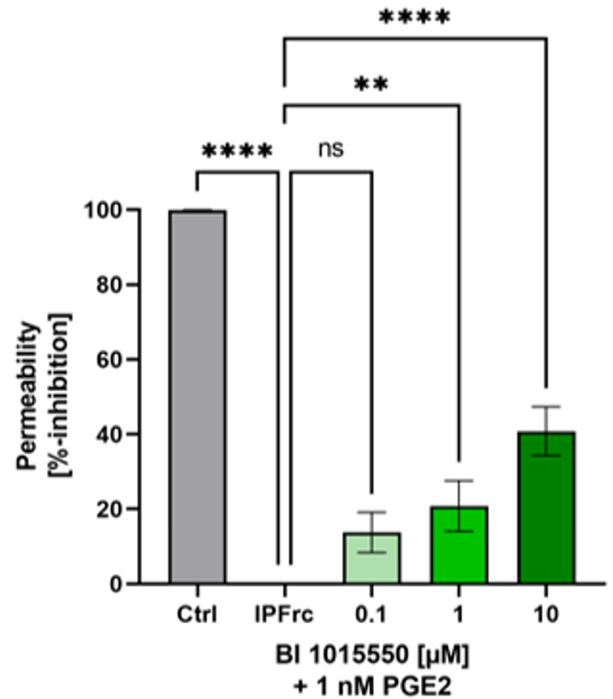
Nerandomilast suppresses endothelial activation and injury
VCAM
Monocyte
Adhesion
Inhibition of inflammatory activation of endothelial cells (VCAM expression)
Inhibition of monocyte adhesion
(potentially transmigration)
Stabilizing barrier function, reducing permeability
Permeability

Slide 26
CONQUEST trial: Nerandomilast ph2b in SSc-ILD
CONQUEST (NCT06195072) is a multicentre, double-blind, randomized, placebo-controlled, Phase 2b platform trial evaluating the efficacy, safety and pharmacodynamics of multiple investigational products to treat early active systemic sclerosis with interstitial lung disease (SSc-ILD) versus placebo.
- Target patient number: n=400 (134 for Nerandomilast)
- Primary endpoint: FVC (lung) → SSc-ILD
- Secondary endpoint: rCRISS (composite endpoint: lung, skin, PROs) → broad SSc
Original Plan: Interim Analyis of CONQUEST triggers initiation of internal PhIII: Sep 2025
Current status of CONQUEST:
- Slow recruitment: Aug 21, 2024: nera’s FPI on Aug 21, 2024; until Jun 18, 2025, only 34 nera pts were randomized (total 63).
- Timeline was adjusted for a 15-month delay → DBL moves from Jan 2027 to Apr 2028
- Interim analysis move to Jan 2027, 1.5 years delay. Launch will only be in mid 2032 with best case if keep the original plan.
Global strategy: PhIII initiation in preparation without waiting for CONQUEST data supported by SSc-ILD data from FIBRONEER-PPF with 18 mg dose strength.

Slide 27
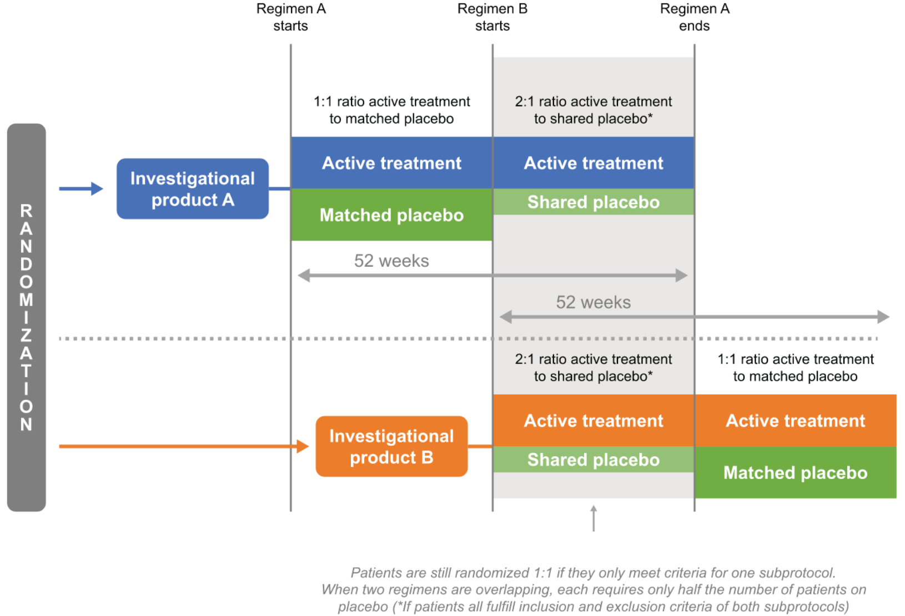
CONQUEST trial: ph2b in SSc-ILD, Nerandomilast and Amlitelimab
CONQUEST (NCT06195072) is a multicentre, double-blind, randomized, placebo-controlled, Phase 2b platform trial evaluating the efficacy, safety and pharmacodynamics of multiple investigational products to treat early active systemic sclerosis with interstitial lung disease versus placebo.
Primary endpoint: Change in FVC from baseline at W52.
Secondary endpoint:
- Change in HRCT QILD-WL score at W52.
- Change in FACIT-Dyspnoea score at W52.
- % patients with improvement in revised CRISS score at W52.
- Change in mRSS at W52.
- Safety and tolerability.
Treatment: Nera 18mg bid.

Slide 28
Primary endpoint used in other SSc trials
 | Nerandomilast (BI) | Tocilizumab (Roche) | Rituximab (Roche) | Anifrolumab (AZ) | Avenciguat (BI) | HY-021068 (合肥恩瑞特）
MoA | PDE4bi, oral | Anti-IL-6, sc | Anti-CD20, iv | Anti-IFNAR1, sc | sGC activator, oral | TXA2i, oral
Development stage | Ph3 under planning | Approved for SSc-ILD in US based on ph3 | Approved for SSc in JP based on IIT (ph2) | Ph3 ongoing,MRCT, China join | Ph2 completed, MRCT, China join | Ph2 ongoing, China alone
Target population | SSc | SSc | SSc | SSc | SSc | SSc
Primary endpoint | Time to disease progression or death | Change in mRSS score at W48 | Change in mRSS score at W24 | Number of responders based on at W52 | Annual rate of decline in FVC at W48 | Change in mRSS score at W48

Slide 29
Considerations for Primary Endpoint Selection
 | Time to Disease Progression | rCRISS
General | Focus on disease worsening → easier to interpret and often used in other indications Relatively easy to implement and adjudicate. Lower risk due to fewer components. Can be used for all SSc pts Not yet used as primary endpoint in SSc (except in stem cell transplant trials): may not fully capture the multi-system nature of SSc or improvements in QoL | More comprehensive and patient-centered Captures "improvement" which is what rheumatologists want to offer patients Created only for dcSSc pts Challenging due to multiple domains and thresholds. Higher risk due to reliance on multiple domains.
Patient Centricity | Includes multiple progression criteria. Limited focus on patient-reported outcomes. | Covers multi-system involvement and patient reported outcomes
Regulatory Acceptance | Lack of precedence except for haematopoetic stem cell transplant in SSc | FDA buy-in with qualification plan implemented in PhIII DAISY trial (anifrolumab, TLR: Q4/2026)
Clinical Concept | Focuses on disease progression and worsening. | Captures improvement (Step 2) and absence of severe disease worsening events (Step 1)
Clinical Relevance | Status June 2025: valued higher by experts, physicians, patients & payer | Author of rCRISS (Prof. Khana): Clinical relevance to be demonstrated. However, in rheumatology many of the composite EPs lack it, e.g. ACR20, BICLA, SRI4 etc.
Timelines | 12 months, but only if required event rate is fulfilled Current design with 560 pts: ≥ 3.7 years | 12 months Current design with 462 pts: 3.4 years

